Slide 1
Species (rat, mouse, human, bovine)
10/10/2024

Slide 2








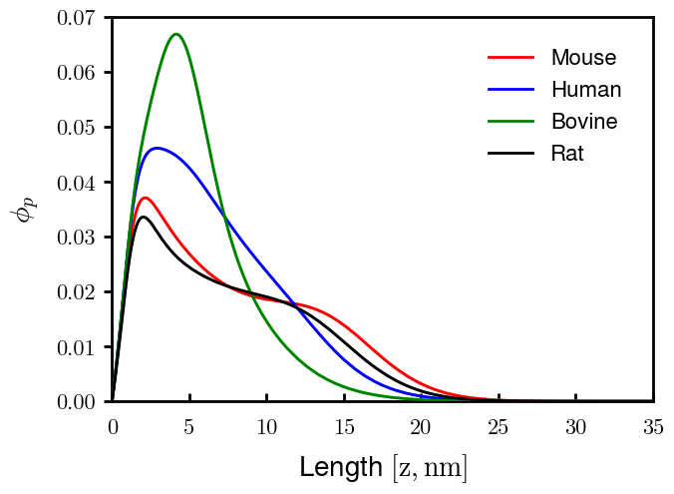
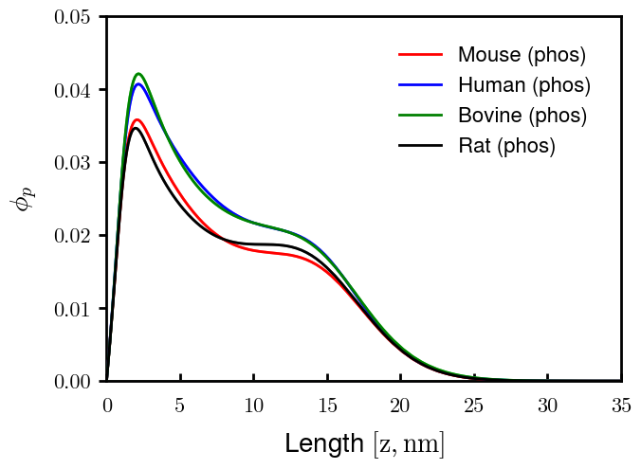
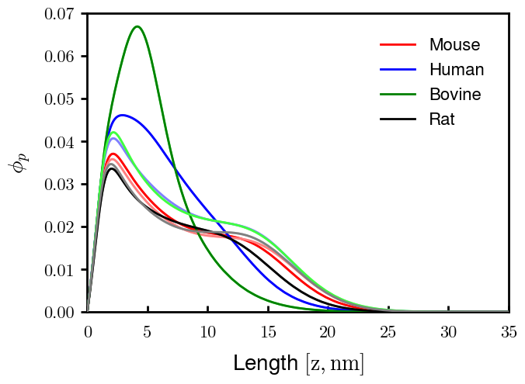
Summary
Charge densities chosen based on best fit to cusum; only qualitative differences in distribution, no effect to comparison between species
Rat (non-phos top, phos bot)
Mouse
Human
Bovine
Pure NFM brushes at grafting density 0.0278 c/nm2, 150 mM
Light colors phos.

Slide 3
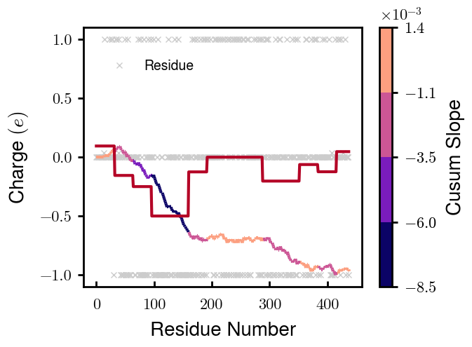
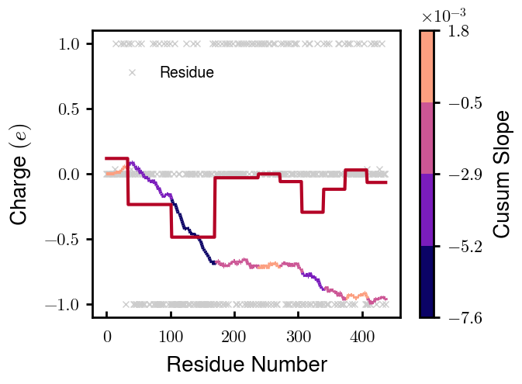

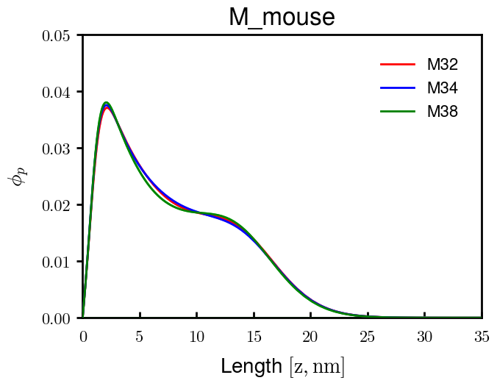
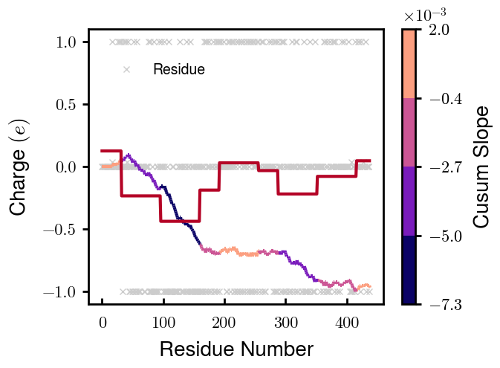
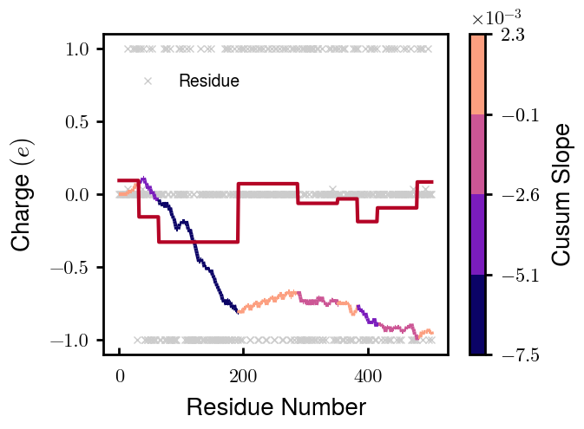
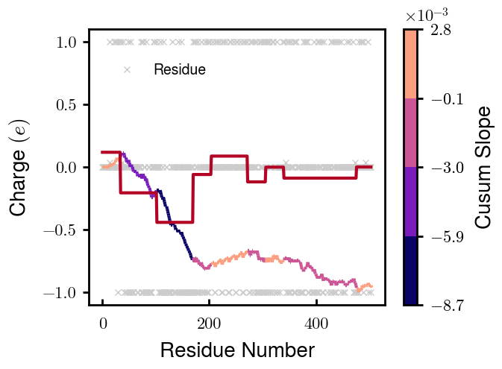
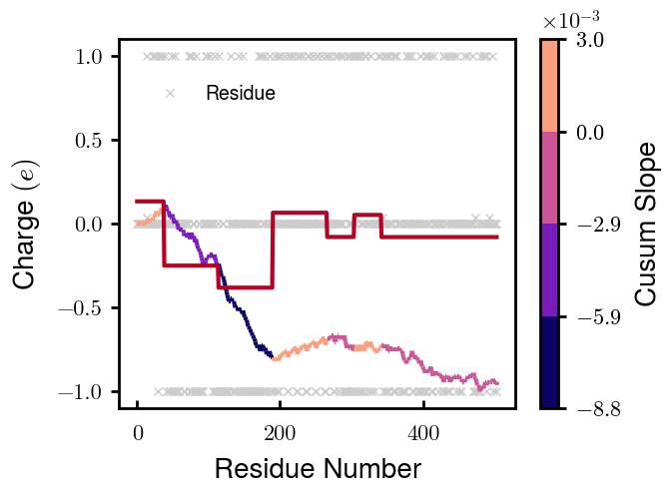
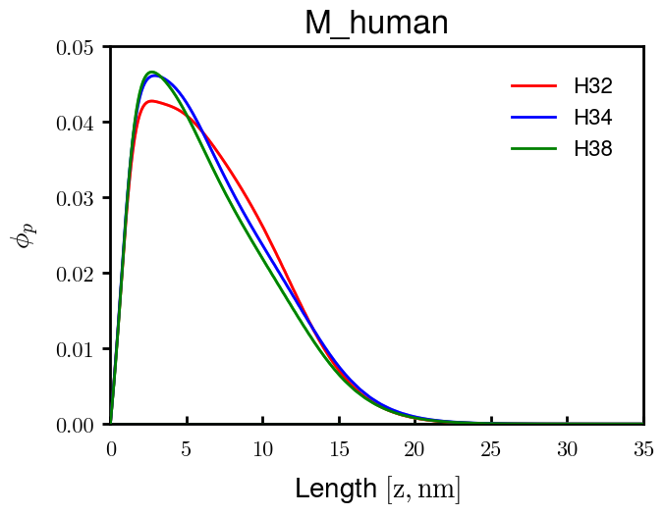
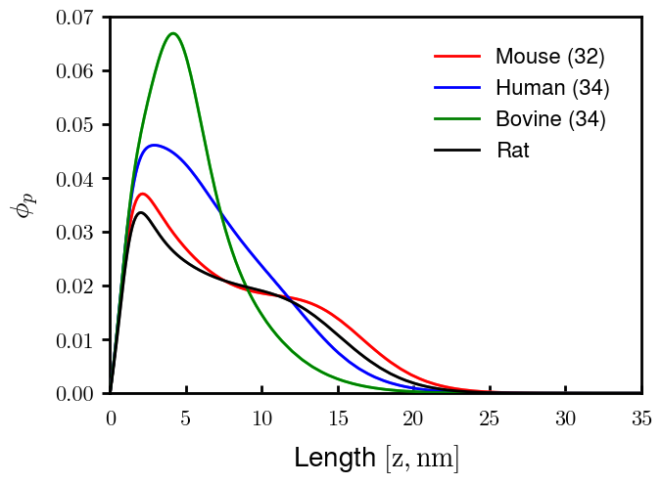

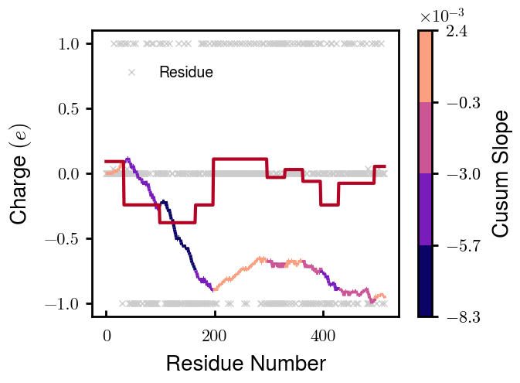
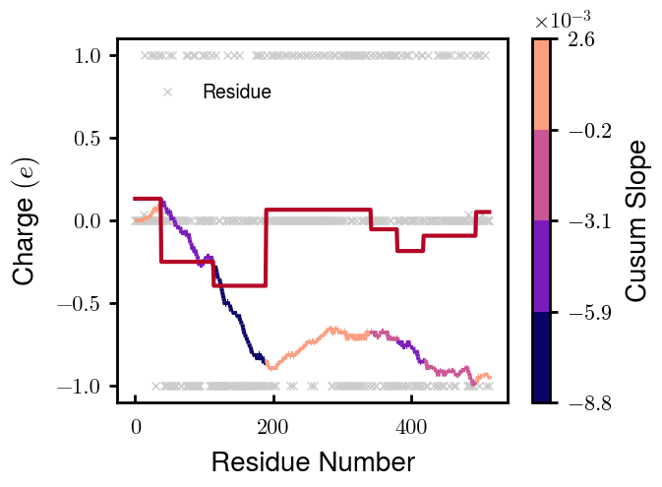
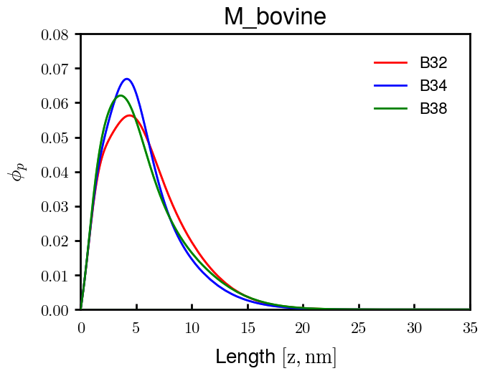
M mouse (32:4[10])
M mouse (34:4[10])
M mouse (38:4[9])
M rat (32:4[9])
M human (32:4[9])
M human (34:4[9])
M human (38:4[7])
M bovine (32:4[8])
M bovine (34:4[10])
M bovine (38:4[8])

Slide 4



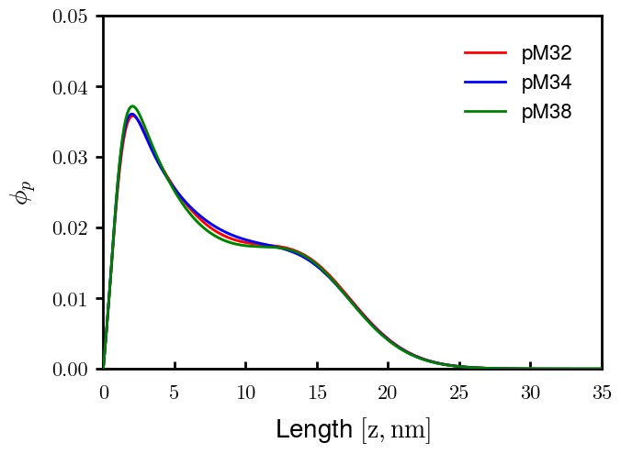

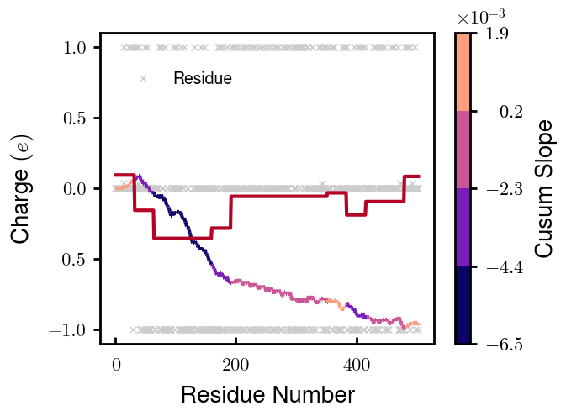
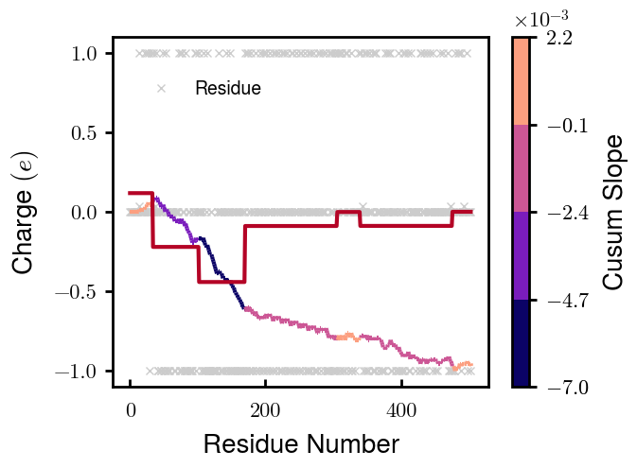
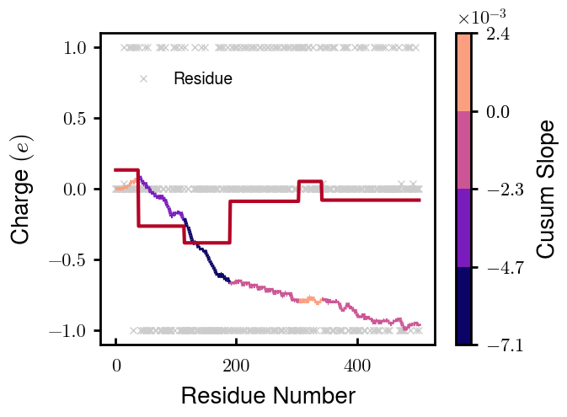
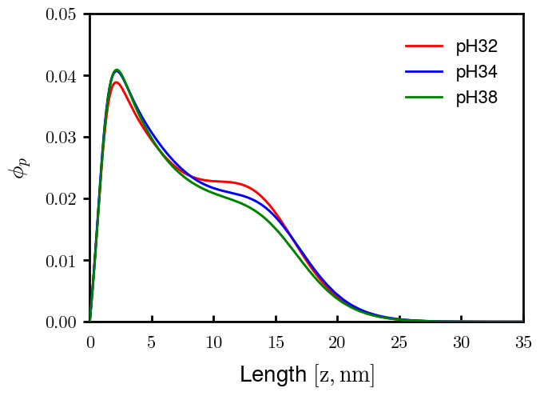
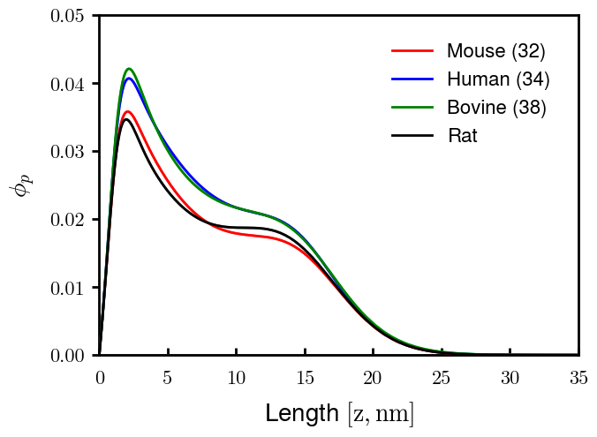
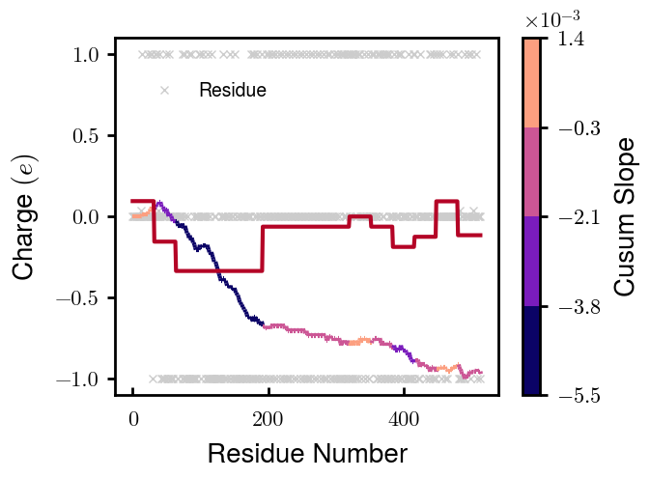


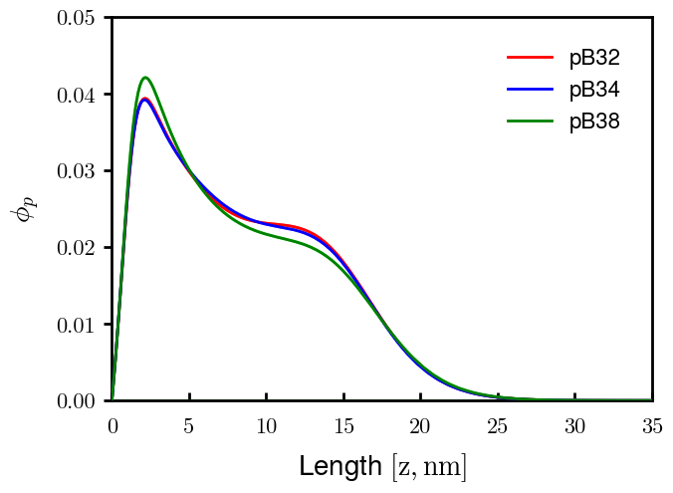
pM mouse (32:4[10])
pM mouse (34:4[10])
pM mouse (38:4[10])
pM rat (32:3[9])
pM human (32:4[9])
pM human (34:4[7])
pM human (38:4[6])
pM bovine (32:4[10])
pM bovine (34:4[8])
pM bovine (38:4[9])

